Slide 1
MTT - Final Presentation
Ben Rarrick, Nick Albanese, Jimmy Mansmann

Slide 2
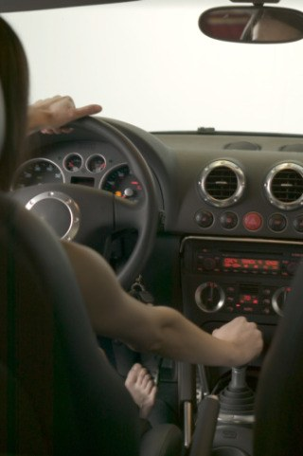
Design Purpose
Make a device to aid people in learning to drive an manual vehicle
Hardware/software package which will provide real time suggestion to the driver
Predict current gear and use with current conditions to suggest driver action
Self contained device

Slide 3
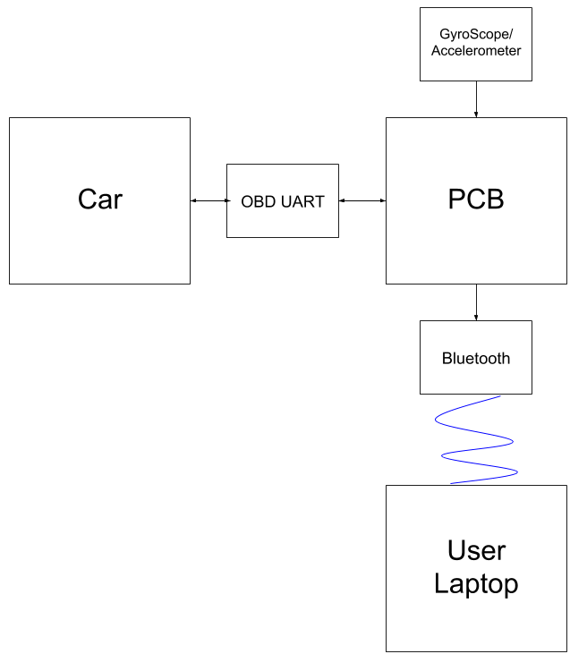
High-Level Block Diagram

Slide 4
MTT- Hardware Diagram
Car
5 V
12 VDC
12 VDC
5 V
GND
MCU - PCB
GND
OBD II Uart
Gyro/Accel/Mag
GND
J1850 +Data
SLA
RX
SDC
TX
J1850 - Data
5 V
GND
RX
TX
Bluetooth

Slide 5
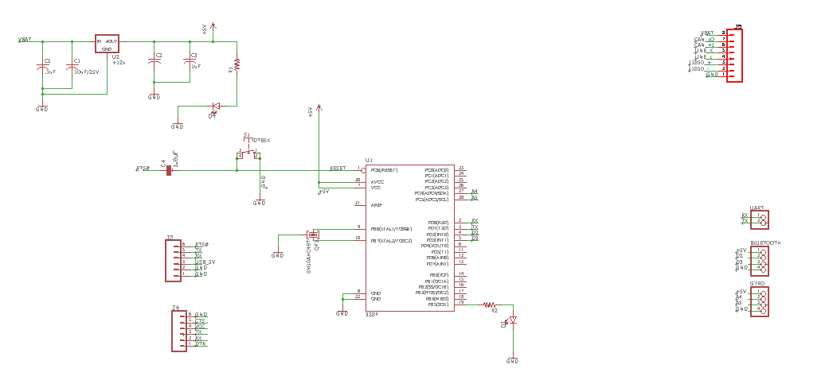
MCU PCB Schematic

Slide 6
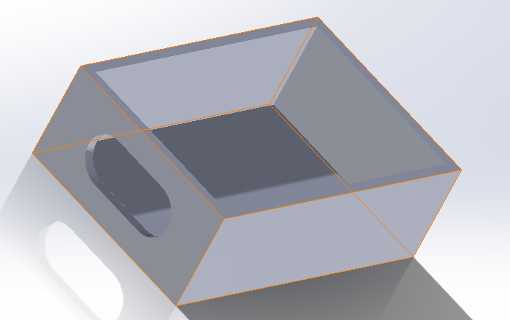
Housing Design

Slide 7
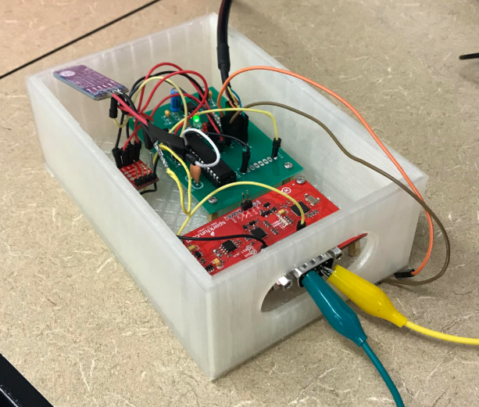
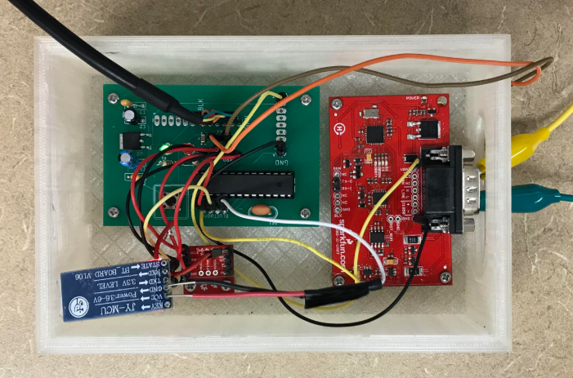
Realization

Slide 8
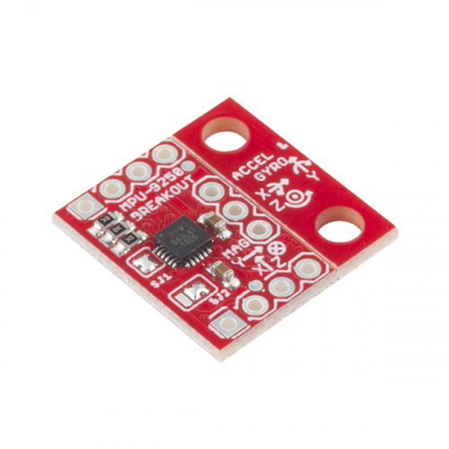
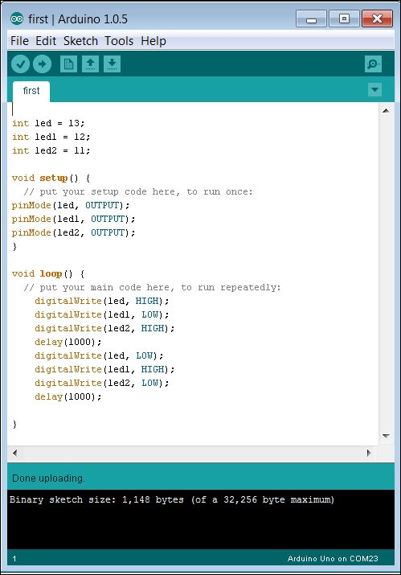
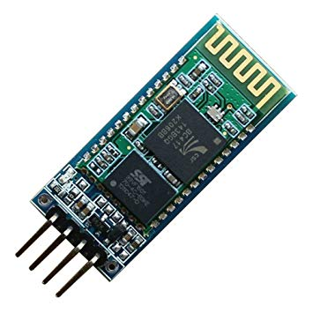

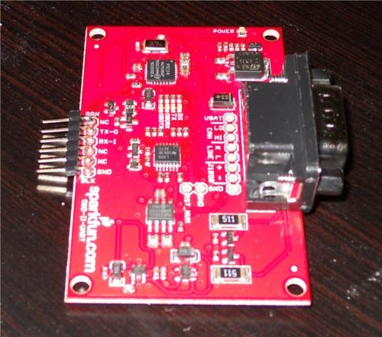
Data Acquisition
Gyroscope/Accelerometer
Arduino Code
Bluetooth Transceiver
Readings
CSV String
OBDII UART
Commands
Response
Notes:
Software Serial vs serial for UART

Slide 9
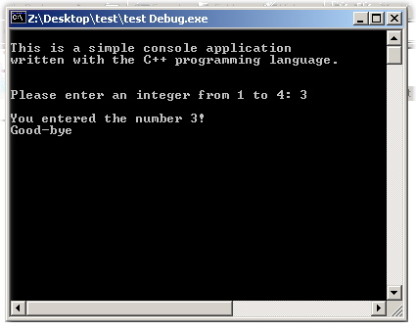
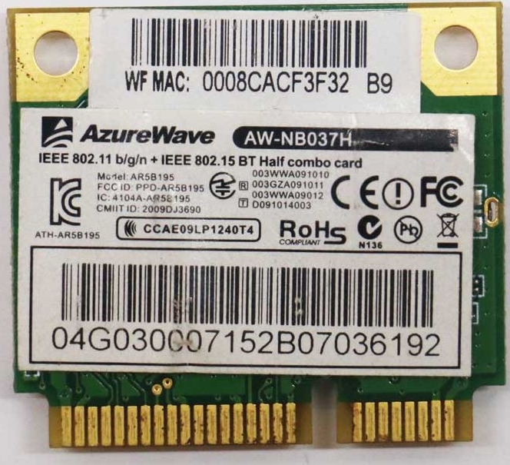
Data Transfer with Bluetooth
C++ Console Application
Laptop Bluetooth Chip
Bluetooth Signal
Bluetooth Transceiver
Serial COM Port 4
CSV String

Slide 10
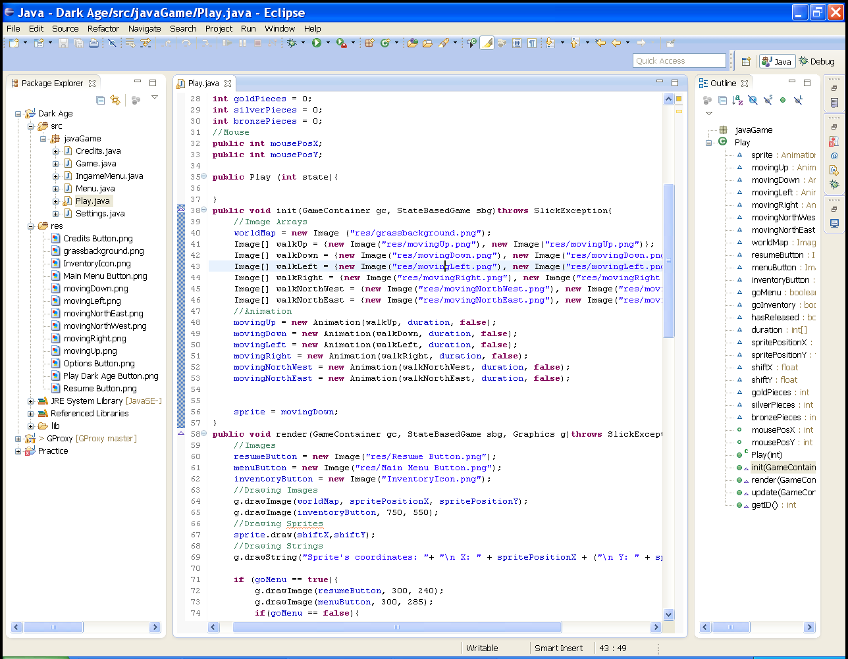

C++ to Java Communication
Named pipes are a means of Interprocess Communication (IPC)
Java Back-end
Named Pipe
C++ Console Application
CSV String
CSV String

Slide 11
Algorithm Implementation
Machine Learning to determine the current gear of car
Decision Tree
Tree trained with 11,000 instances of data
<accuracies of each gear>
Real-time car data read in 2 times per second
Data is parsed and given to trained tree
Tree is traversed and ends at leaf node containing the predicted current gear of car
Real-time car data also given to best-practices algorithm
If-statement that uses car’s current RPMs to determine if an upshift is needed
UI updated to display suggested action to user

Slide 12
Tree File Outputs
6th_gear_tree.png
6th_geaer_no_load.png

Slide 13
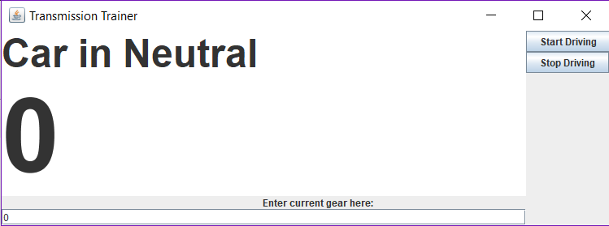
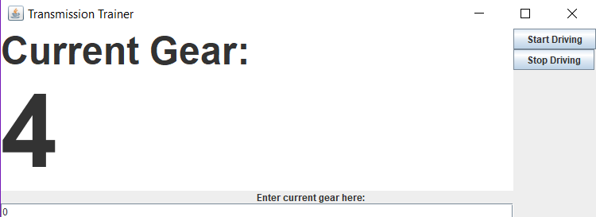
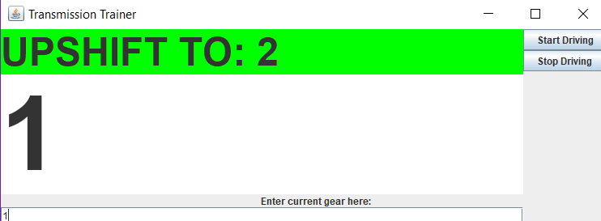

Slide 14
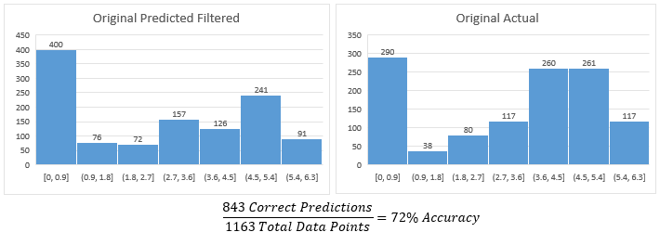
Testing

Slide 15
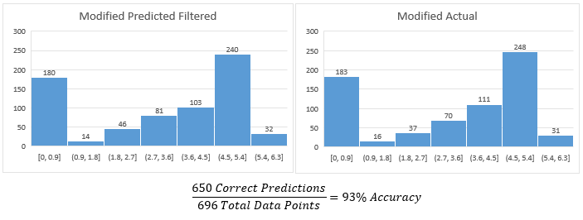
Testing

Slide 16
Conclusions/Future Work
Consolidate and minimize hardware
Implement decision pruning and filtering data spikes
Properly implement gyroscope/accelerometer
Consolidate code on laptop into one executable
Design and implement down shifting functionality

